Slide 1

Team 1 Machida Hiroaki Ding Shenjie Deshpande Amol Sinha Shaurya Shenyuan Wu Peiyan Duan

Slide 2
Access! http://team1.work

Slide 3
Table of Contents
http://team1.work
Overview Concept User stories Architecture
Status report Iteration 1-2 Iteration 3 Issues
Demo Buy textbook from market (All) Auto complete book cover (Shenyuan) Barcode reader (Hiroaki) Recommendations Feature (Amol)
Wrap-up Application Completeness Clarity in Presentation Understanding of SW Engineering Practices Good Use of Resources

Slide 4


Users can sell & buy used textbooks
Overview - Concept
Figure
Book Exchange
Market
User stories
# | User story
1 | You buy textbook from the market
2 | You post textbook you want in the market and I sell it

Slide 5
You buy textbook from the market
Overview - User story #1
Figure
I sell this!
I buy that!
Book Exchange
Market
User story
# | Action
1 | I post textbook for selling.
2 | You buy textbook
3 | I ship textbook
4 | You receive textbook!
5 | You write review about me

Slide 6
You post textbook you want in the market and I sell it
Overview - User story #2
Figure
I need this!
I have that!
Book Exchange
Market
User story
# | Action
1 | You post textbook for buying.
2 | I sell textbook
3 | I ship textbook
4 | You receive textbook!

Slide 7
React + Redux for application and Firebase Realtime Database for database
REPEAT
Overview - Architecture(Application)
AWS
React + Redux
Node.js
Firebase
Firebase Realtime Database

Slide 8









MRTG for monitoring, Cypress for IT, BERT-SQuAD for NLP and iTunes for book cover auto complete
Overview - Architecture(Infrastructure)
Server monitoring
Developers
Image Auto Complete
Natural Language Processing
Cron
BERT-SQuAD
Integration test

Slide 9
Prototype implemented and released, and CI/CD environment is set up on iteration 1
REPEAT
Status report – Iteration 1
# | Item | Person in charge | Status
1 | Framework setup | Shaurya | Done
2 | DB schema design | Shaurya | Done
3 | CI/CD environment setup | Hiroaki | Done
4 | Minimum user story | Hiroaki | Done
5 | User review | Amol | Done
6 | Post for buying textbook | Shenyuan + Shaurya | Done
7 | Bar code detection | Shenjie | In progress
8 | Auto completion for search | Peiyang + Machida | Done

Slide 10
Server monitoring is set up and NLP for category detection is integrated to the project
REPEAT
Status report – Iteration 2
# | Item | Person in charge | Status | Reason for not completed
1 | Server Monitoring | Hiroaki | Done | -
3 | UI Improvement - Menu and Tx Flow | Hiroaki | In progress | Sickness Return to home country
4 | UI Improvement - Overall Design | Amol | In progress | Workload outside class Sickness
5 | Category Detection | Hiroaki | Done | -
6 | Category Search | Shenyuan + Peiyan | Done | -
7 | Paypal Payment | Shaurya | In progress | Workload outside class
8 | Barcode Reader | Shenjie | In progress | No face-to-face support
9 | Event Notification | Hiroaki | Done | -

Slide 11
Further user experience improvement has come on iteration 3
Status report – Iteration 3
# | Item | Person in charge | Status | Reason for not completed
1 | UI Improvement - Menu and Tx Flow | Hiroaki | Done
2 | Paypal Payment | Shaurya | In progress | Technological issue
3 | Barcode Reader | Hiroaki | Done
4 | Return Book | Hiroaki + Shaurya | Scoped out | Workload too high for remaining on iteration 2
5 | Auto complete Book Cover | Shenyuan + Shenjie | Done
6 | Recommendations Engine | Amol | Done

Slide 12
Resolution plans for two major issues have been utilized
Status report – Issues
# | Issue | Detail | Resolution plan
1 | Corona virus pandemic | No more face-to-face support for implementation Implementation progress is not good | Reschedule and change the scope “Return book” scoped out
2 | High workload outside class | Some members have high workload outside class and cannot proceed tasks | Keep it going. Cannot control situation outside of class Change task owners accordingly to avoid bottlenecks

Slide 13
Demo Buy textbook from market (All) Auto complete book cover (Shenyuan) Barcode reader (Hiroaki) Access! http://team1.work

Slide 14
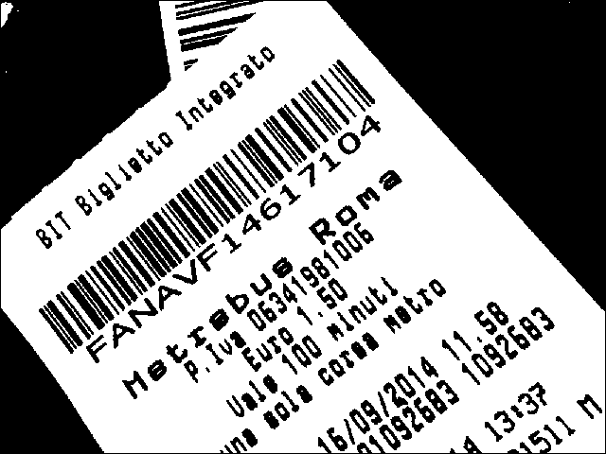

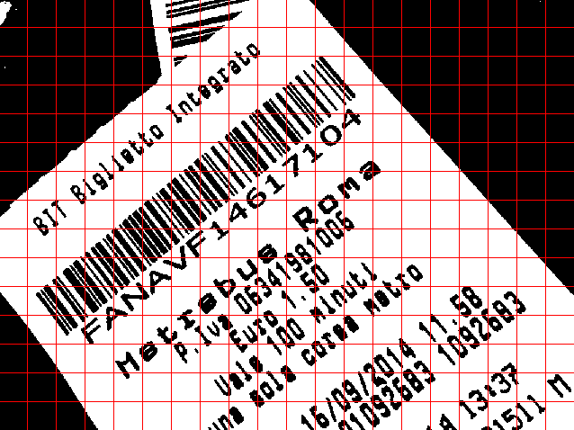

QuaggaJS finds barcode by looking for lines, which are close to each other and have a similar angle.
Demo – How to read barcode?
Create a binary representation of the image
Slice the image into a grid (20 x 15 cells)
Extract the skeleton of each cell
Component labeling

Slide 15
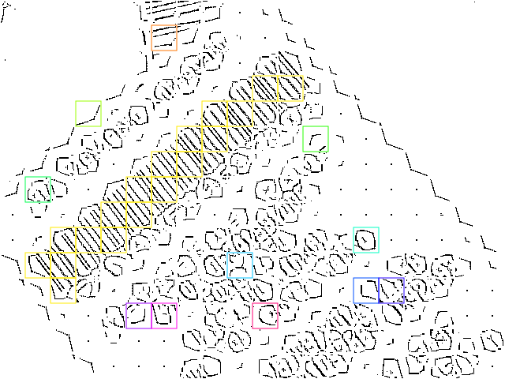
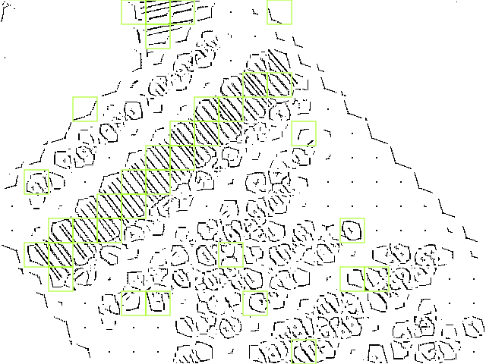
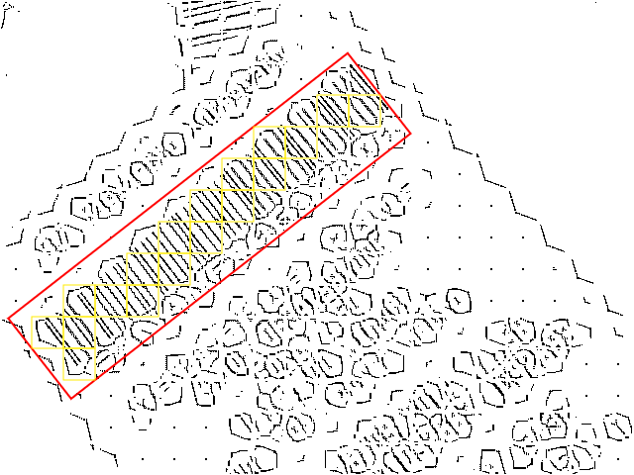
QuaggaJS finds barcode by looking for lines, which are close to each other and have a similar angle.
Demo – How to read barcode?
Calculate the rotation of each part
Determine cell quality (rotation uniformity)
Find connecting cells with similar rotation
Create bounding box of connected cells
Decode

Slide 16

Application is complete in terms of basic user story, advance ML technology and production release
Application Completeness
Basic User Story
Two basic user stories has been successfully implemented.
Buy textbook from the market
Post textbook in the market and someone sells it
Advance Machine Learning Technology
Two advance machine learning technology has been also successfully integrated.
Category detection with BERT-SQuAD (as well as AI based classification model.)
Barcode reader with QuaggaJS
Production Release
The application has been successfully deployed to production environment and everyone on the internet can use it.
http://team1.work/
Advantages of this team

Slide 17
For Clarity in Presentation, topics are organized, demo is based on user story and wrap-up added
Clarity in Presentation
Organized Topics
Topics are organized from the concept to details in the following order so that everyone understands this project.
Overview
Status report
Demo
Wrap-up
Demo based on User Story
Demo is done through the whole user story since we got feedback that how the application works for selling and buying the book including the MRTG was not quite clear.
Wrap-up
Wrap-up is added to this presentation for readers to have better understanding of this project.
Advantages of this team

Slide 18
Software Engineering Practices in the class are utilized for project
Understanding of
SW Engineering Practices
Advantages of this team
Software Products
Early version is implemented and released as prototyping on iteration 1.
Agile Software Engineering
Iterative development is adopted as agile method.
Features, Scenarios, and Stories
Scenario and user stories are utilized for project.
Software Architecture
Architecture is selected by doing pros and cons comparison.
Cloud-Based Software
Application is running on AWS that utilizes virtualization.
Microservices Architecture
BERT-SQuAD server is launched as microservice.
Security and Privacy
Firebase Authentication is used for user authentication
Reliable Programming
Observer pattern is used in Redux and that contributes to fault avoidance.
Testing
Cypress is utilized for integration test automation.
DevOps and Code Management
CI/CD environment is implemented as DevOps automation.

Slide 19
Resources are allocated to maximize the output of team in consideration of skill and constraints
Good Use of Resources(1/2)
Name | Skills | Constraints | Ite# | Tasks & Implementations | Completion
Machida Hiroaki | Work experience as consultant & SWE |  | 1-3 | Status report draft | ✓
 |  |  | 1-3 | Presentation draft | ✓
 |  |  | 1-3 | User manual | ✓
 |  |  | 1 | CI/CD environment setup | ✓
 |  |  | 1 | Buy textbook from market | ✓
 |  |  | 1 | Auto completion for search(logic) | ✓
 |  |  | 2 | Server monitoring | ✓
 |  |  | 2-3 | UI imrovement - menu and tx flow | ✓
 |  |  | 2 | Category detection | ✓
 |  |  | 2 | Event notification | ✓
 |  |  | 3 | Barcode reader | ✓
Ding Shenjie | Python & Java | High workload outside class | 1-3 | Barcode reader(feasibility check) | ✓
 |  |  | 3 | Auto complete book cover

Slide 20
Resources are allocated to maximize the output of team in consideration of skill and constraints
Good Use of Resources(2/2)
Name | Skills | Constraints | Ite# | Task & Implementations | Completion
Deshpande Amol | Working as SWE | Part-time & Sickness on iteration 2 | 1 | User review | ✓
 |  |  | 2 | UI imrovement - overall design
 |  |  | 3 | Recommendations engine | ✓
Sinha Shaurya | Work experience as consultant & SWE | Internship | 1 | Framework setup | ✓
 |  |  | 1 | DB schema design | ✓
 |  |  | 2-3 | Paypal payment
Shenyuan Wu | Python & Java |  | 1 | Post textbook wanting & someone sells | ✓
 |  |  | 2 | Category search(view) | ✓
 |  |  | 3 | Auto complete book cover | ✓
Peiyan Duan | Work experience as mobile app developer | Job-hunting | 1 | Auto completion for search(view) | ✓
 |  |  | 2 | Category search(logic) | ✓
 |  |  | 3 | Recommendations engine

